Slide 1



Kaf Mueen
Trusted Handyman Services

Slide 2

Kaf Mueen: Trusted Handyman Services
Kaf Mueen is a digital marketplace connecting skilled handymen with local customers. Our platform empowers homeowners to find reliable professionals for a range of home improvement tasks. We prioritize quality and trust, offering a seamless experience for both customers and handymen.

Slide 3


The Digital Marketplace for Local Handyman Services
Customers
Handymen
Stores
Post tasks and get quotes
Offer services and set rates
Offer products
Choose reliable handymen
Access new customer leads
Access new customer leads
Convenient scheduling
Manage work schedules
Build reputation and reviews
Track project progress
Build reputation and reviews

Slide 4





Connecting Skilled Tradesmen with Customers
Local Focus
Verified Professionals
Direct Communication
Transparent Reviews
Kaf Mueen prioritizes local connections, matching customers with nearby skilled handymen.
Our platform features background-checked and experienced handymen.
Customers and handymen can communicate directly to discuss project details.
Building trust through honest customer reviews and ratings.

Slide 5
Trusted Services Guarantee: Kaf Mueen's Brand Promise
Verified Professionals
1
Kaf Mueen only allows background-checked and experienced handymen on the platform.
Transparent Profiles
2
Handyman profiles showcase their skills, experience, and customer reviews.
Secure Payments
3
Kaf Mueen offers secure payment processing for both customers and handymen.
Customer Support
4
We provide reliable customer support to address any issues or concerns.

Slide 6
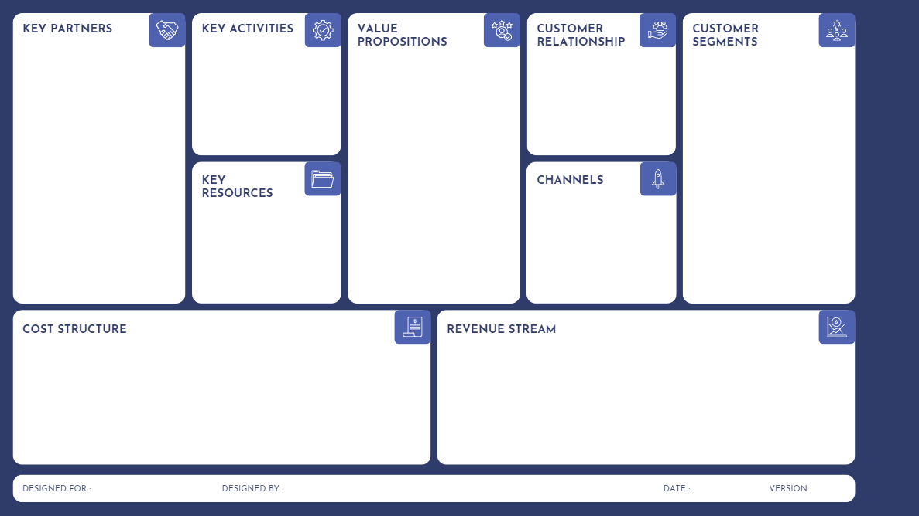
Skilled Handymen (Independent Cotractors)
Local Tool and Equipment Suppliers
Payment Processors (e.g., Stripe, PayPal)
Marketing Agencies
Insurance Providers (to cover service-related risks)
Platform Design and Development
Marketing and Growth Campaigns
Quality Assurance
Managing Relationships
Homeowners
Renters
Small Business Owners
Busy Urban Professionals
Age Group: 25-60
Reliable Local Handyman Services
Easy and Secure Booking with Real-Time Availability
Dynamic Pricing for Affordability and Flexibility
Trustworthy Service with Customer Reviews and Ratings
Personalized Service
Loyalty Programs for Frequent Users
Direct In-App Messaging Between Customers and Handymen
Customer Support Hotline for Inquiries and Problem Resolution
Customer Feedback and Review System for Quality Assurance
Online Platform
Social Media
Email Marketing for Promotions and Updates
Local Partnerships
Platform Infrastructure
Skilled Handyman Network
Brand and Marketing Assets
User Data and Analytics
Platform Development and Maintenance Costs
Salaries for Development, Marketing, and Support Teams
Marketing and Advertising (social media campaigns, partnerships)
Insurance and Legal Compliance Costs
Payment Processing Fees
Customer Service Infrastructure
Service Fees (Commission from Every Completed Task)
Premium Subscriptions for Handymen (increased visibility and exclusive job postings)
Seasonal Promotions and Special Offers
Partnership Fees (collaborations with local tool suppliers)
Advertising on Platform (targeted ads for local services and products)

Slide 7













Tools and Technology
Design Tools
Figma
Development Tools
Visual Studio Code, Git, GitHub, Trello
Frontend
HTML, CSS, JavaScript
Backend
Laravel , MySQL

